Slide 1

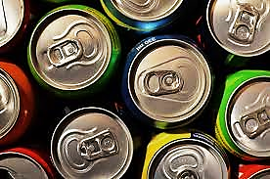
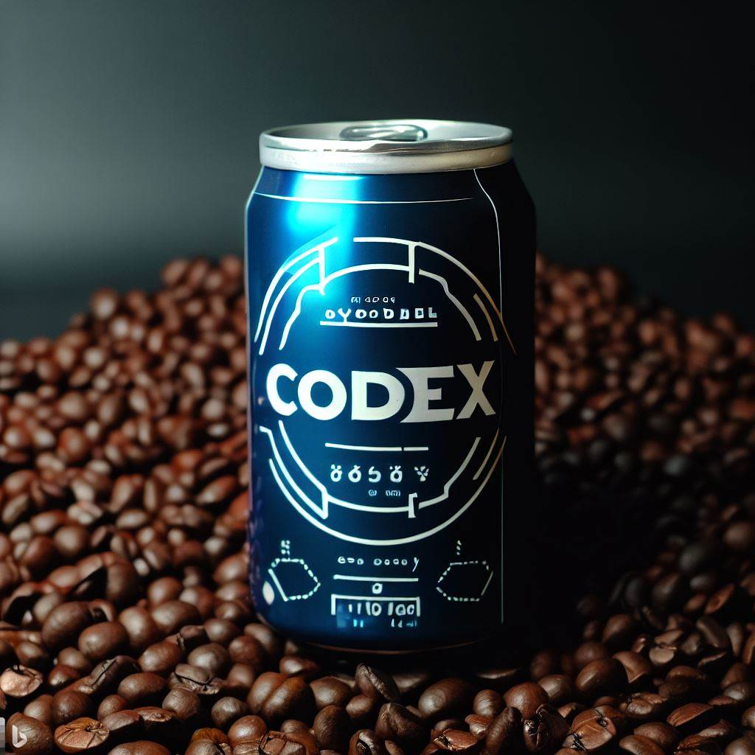
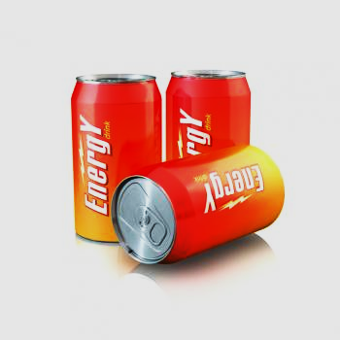
Codex survey analysis
Codebasics resume challenge 6
PRESENTER:
Akash pranao. D.k
Aspiring Data analyst
Notes:
Line spacing + Page numbers

Slide 2
Agenda
01 Company overview
02 Objectives
03 Primary Insights
04 Secondary insights
05 Suggestions
06 Closing

Slide 3
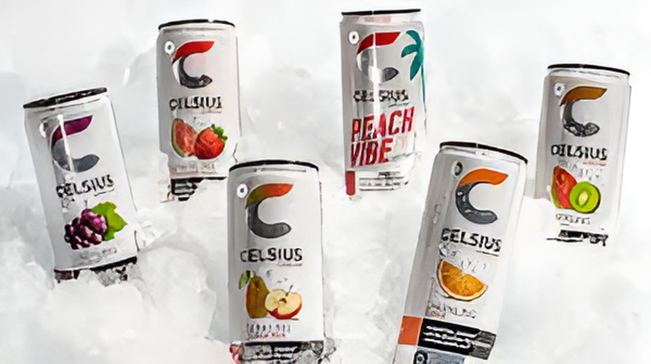
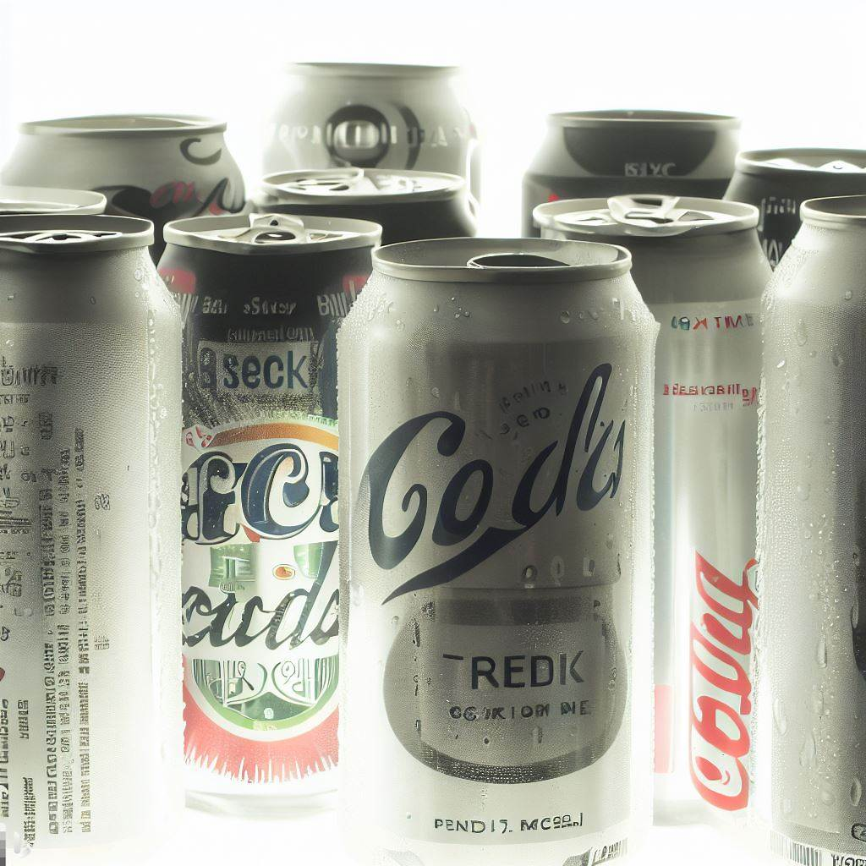
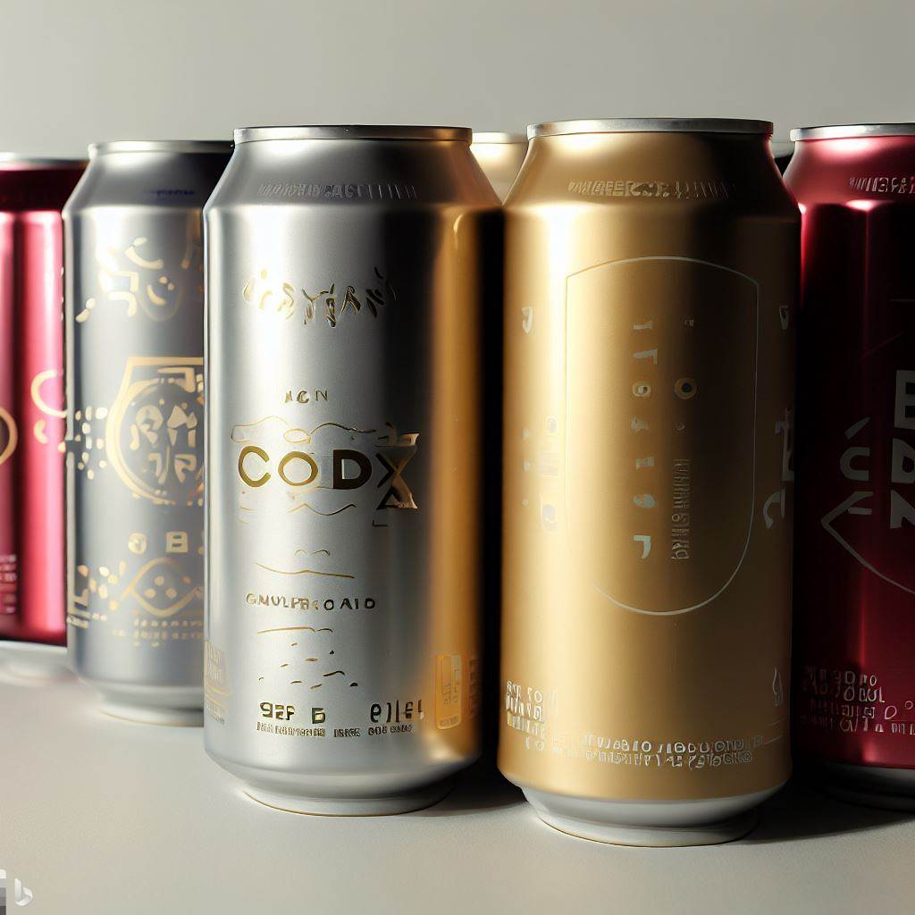
Company Overview
01
CodeX, a German beverage company, has recently made its debut in the Indian market with the idea of launching an innovative energy drink.
To gain valuable insights into the preferences and attitudes of the Indian population, CodeX conducted an extensive survey across 10 major cities in India, with an impressive response rate of 10,000 participants.

Slide 4
Objectives
02
To clean the dataset and process the dataset for analysis.
To extract valuable insights based on various categories for a comprehensive understanding of the market perception.
To prepare concise and impactful visualizations highlighting the most significant insights for the understanding of the chief marketing officer.
To contribute to the development of an effective growth strategy for the company by providing suggestions and recommendations.
Tools:
Data cleaning & processing: Excel
Visualization: PowerBi
Presentation: Power point

Slide 5
Primary insights:
03
Primary insights
Demographic insights
Consumer preference
Competition analysis
Marketing channels
Brand penetration
Purchase behavior
Product development

Slide 6
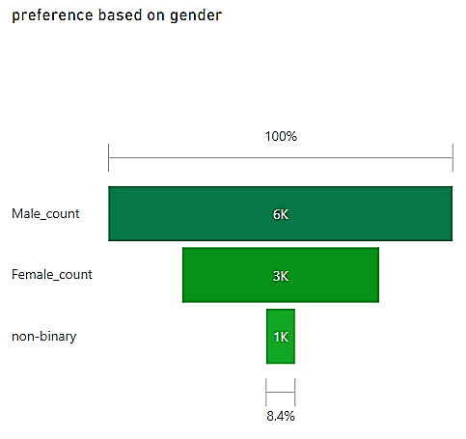
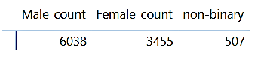
1. Demographic insights
1.1 Who prefers energy drink more(based on gender)
This chart depicts that the survey has focused more on males.
That is we have more male customers than other genders.

Slide 7
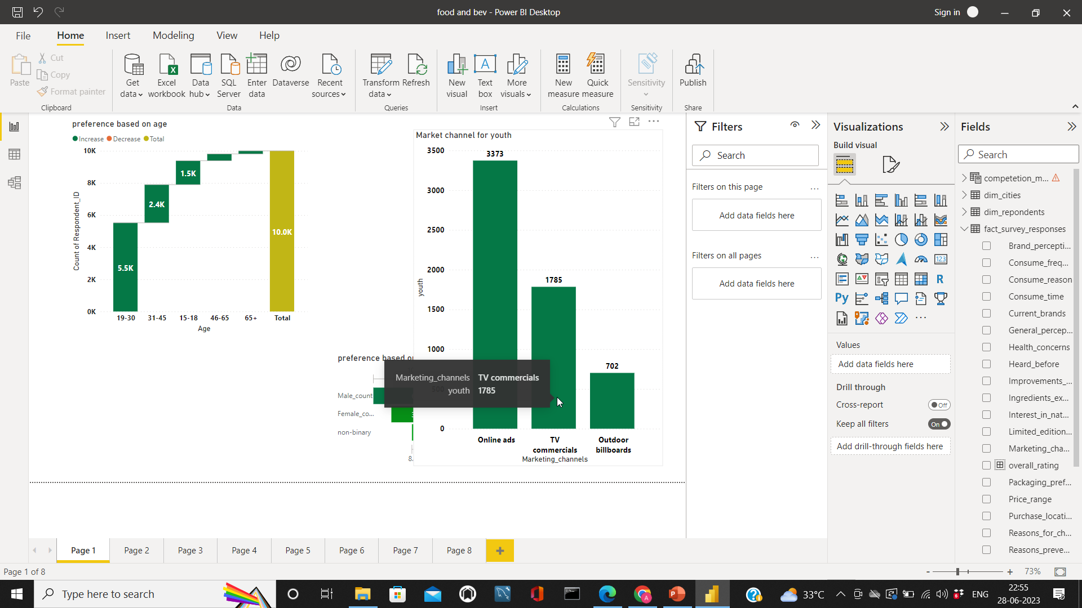
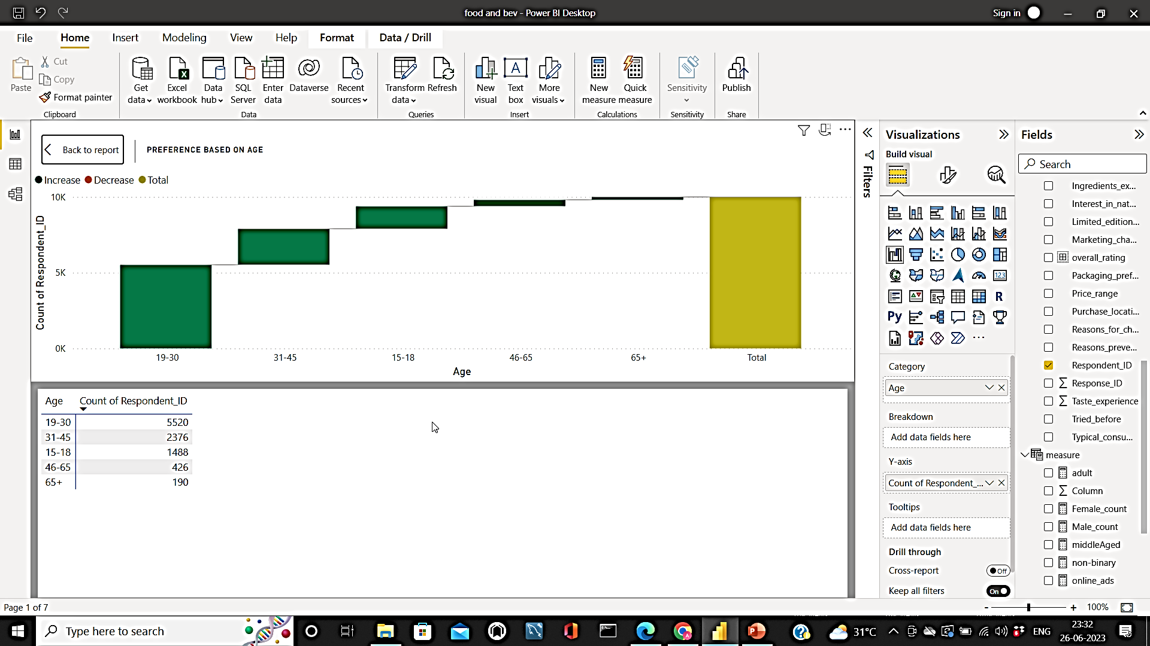
1.2 Which age group prefers energy drinks more?
People between the age of 19-45 are consuming our product more and they are our primary customers.
Our secondary customers are teenagers with age between 15 and 18

Slide 8
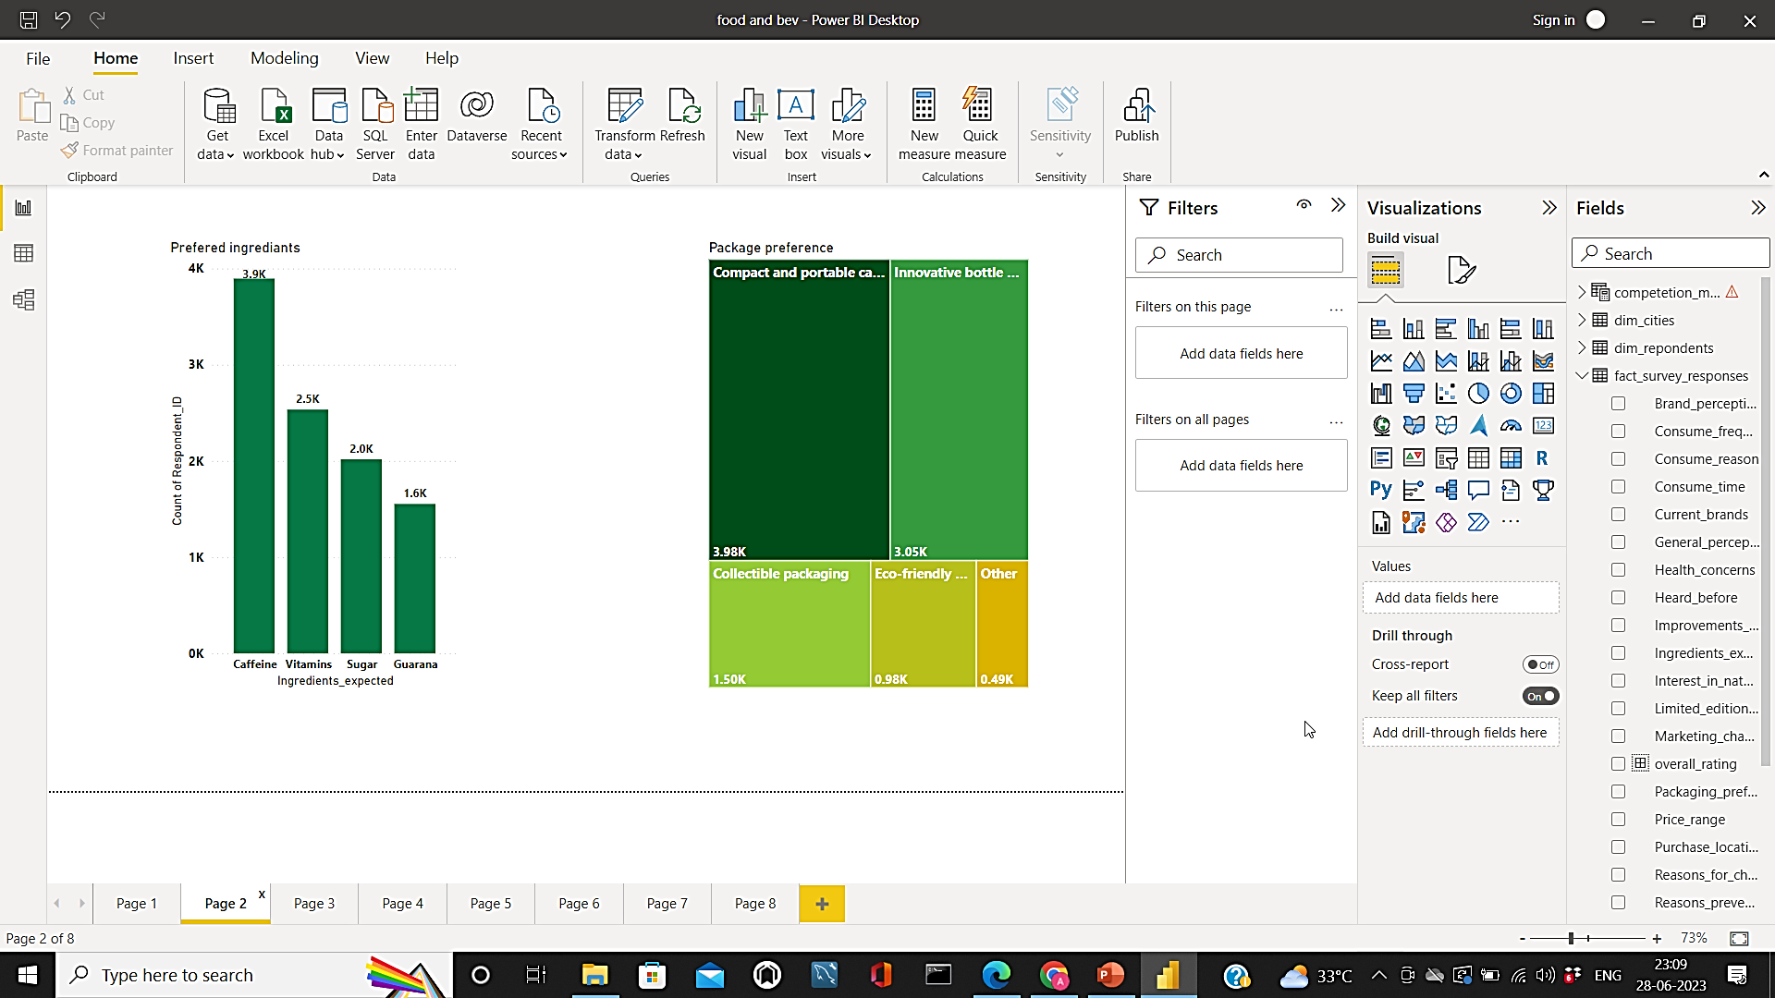
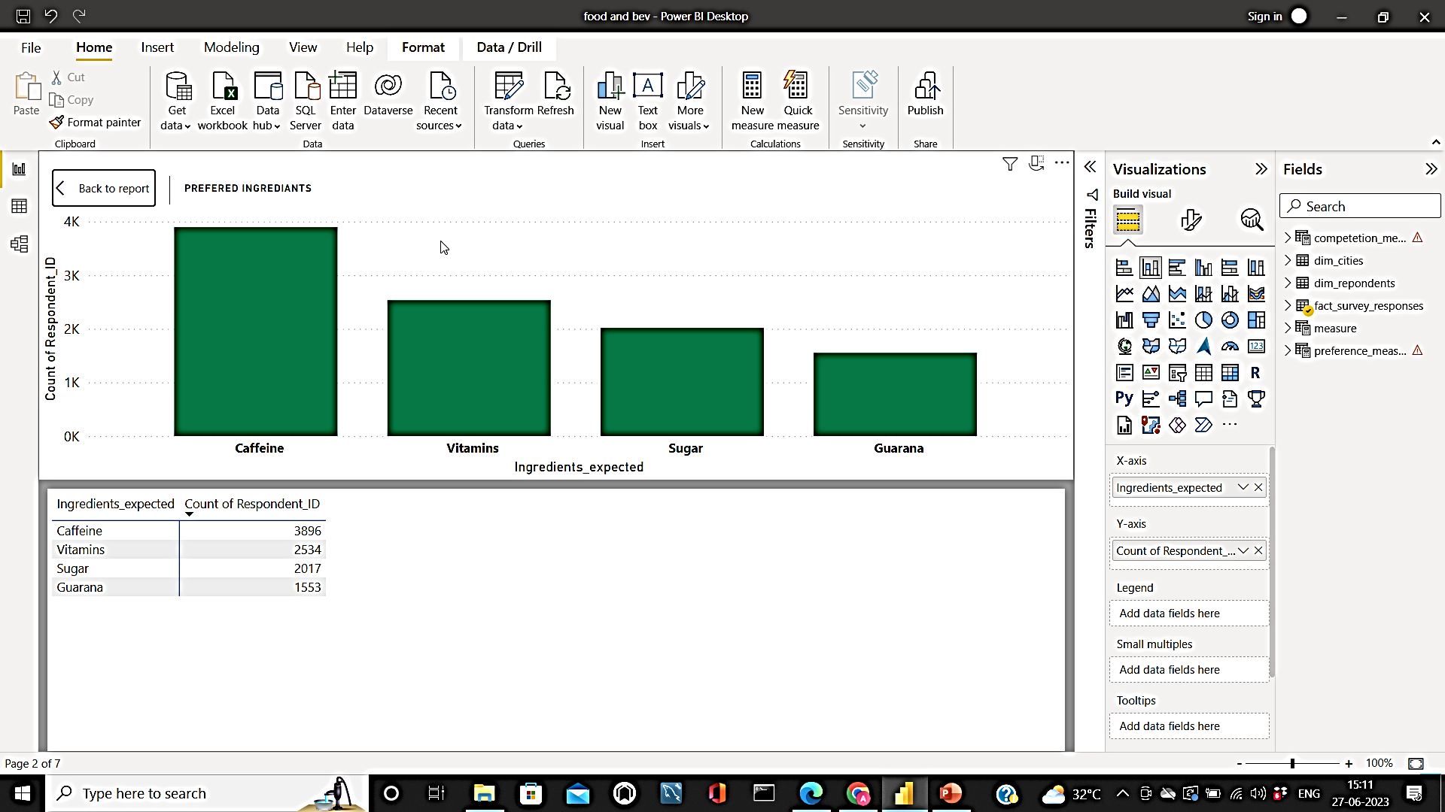
2. Consumer preferences
2.1 Preferred ingredients – energy drink
Our energy drink is preferred by youth and adults to keep them active to perform their activities.
So predominantly they prefer Caffeine in their drink, But there is not much difference between other ingredients.

Slide 9
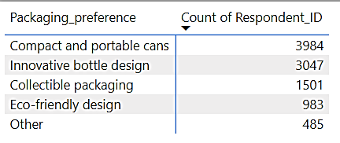
2.2 Packaging preference
The primary response from people has depicted “Compact and Portable cans”. With very less difference people have suggested innovative bottles.
So the brand should come up with an innovative bottle that is compact and portable to reach a wider range of consumers.

Slide 10
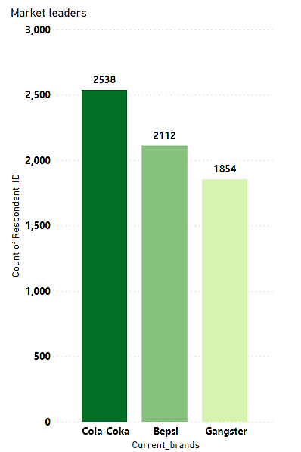
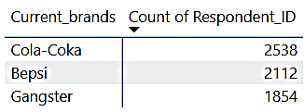
3. Competition analysis
3.1 Current market leaders
Cola-Coka tops the list with 2538 consumers followers by Bepsi and Gangster.
Competitors other than these are more or less equal to our brand.

Slide 11
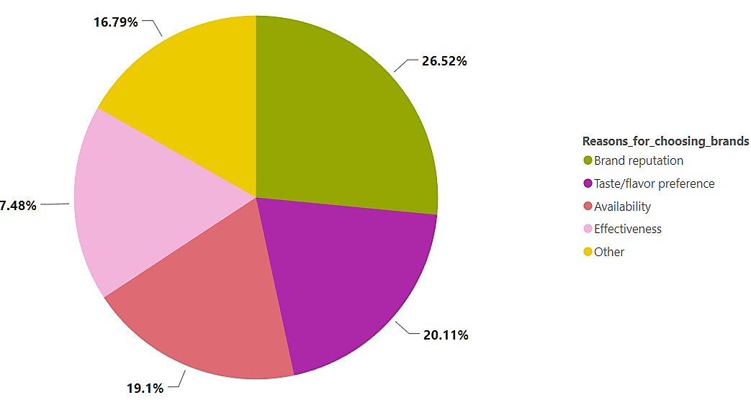
3.2 Reasons for choosing specific brand
This visualization depicts various reasons for selecting a specific brand.
People prefer reputed brands primarily.
The secondary reasons are taste and availability.

Slide 12
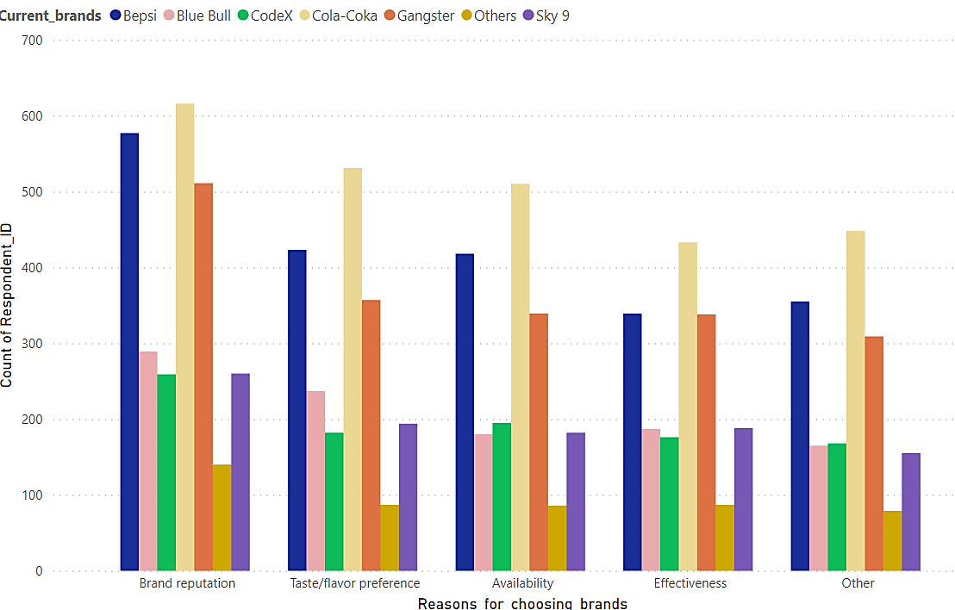
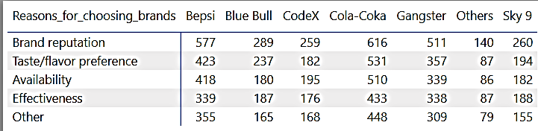
3.3 Comparison with other brands
The above visualization provides benchmarking with other brands to become market leaders our brand should ensure availability, taste, and effectiveness.

Slide 13
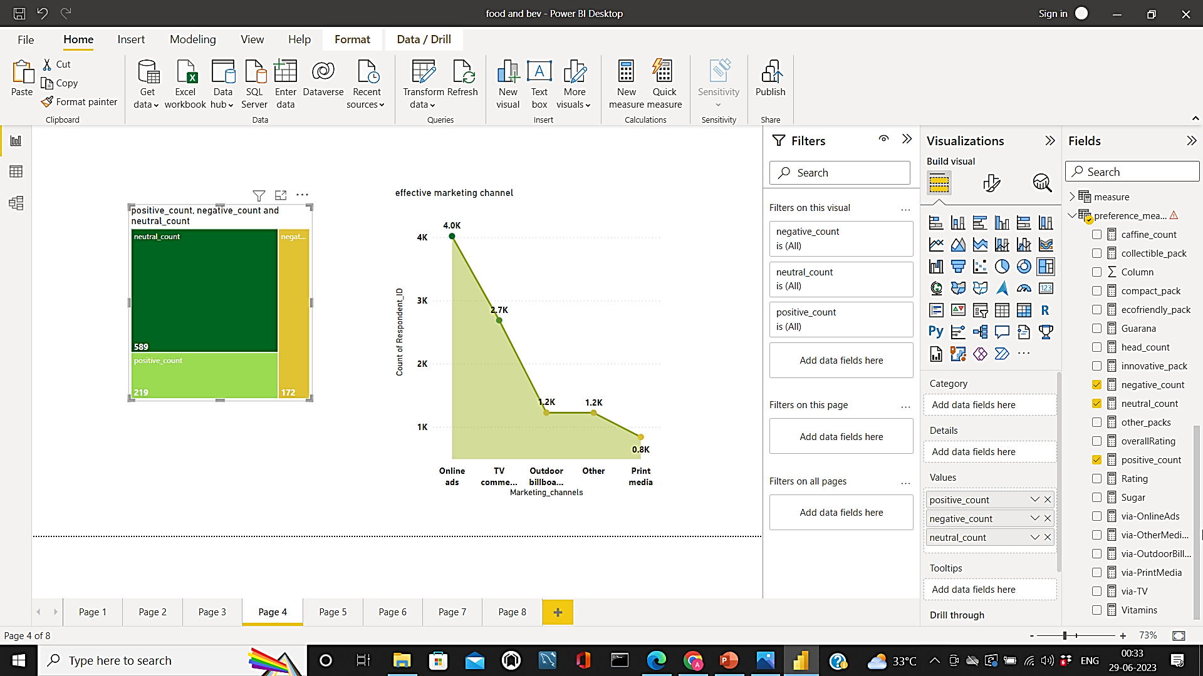
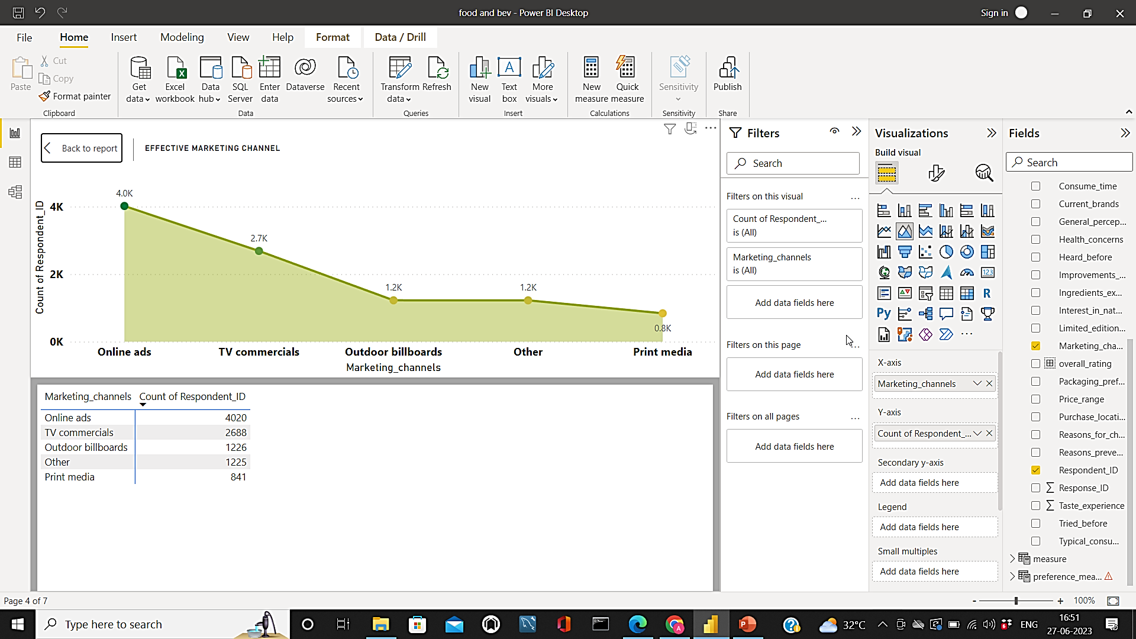
4. Marketing preferences
4.1 Effectiveness of various marketing channels
Since our major consumers are teenagers and adult online medium plays a vital role in marketing.
Print medium seems to be very ineffective in terms of ROI.

Slide 14
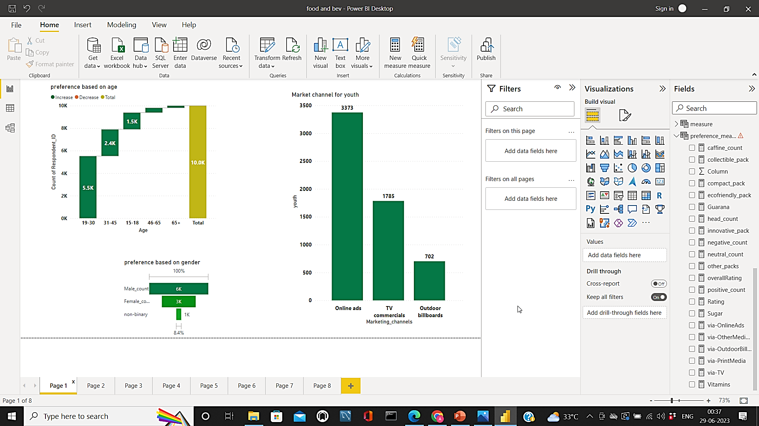
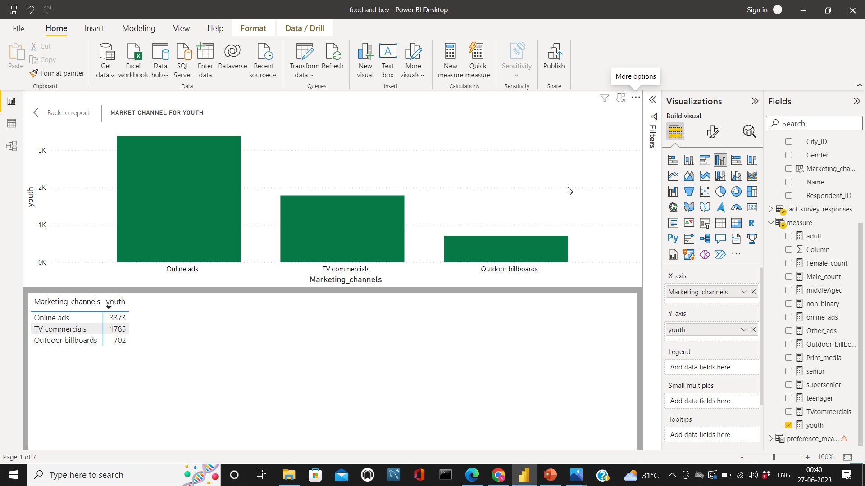
4.2 Best marketing type for youth
Youth spend most of their time entertaining themselves so online media and TV commercials are the best way to reach them.
For social media, we can use digital banners and social media influencers.
For Tv commercials, we should make create advertisements and should also find an actor with good face value.

Slide 15
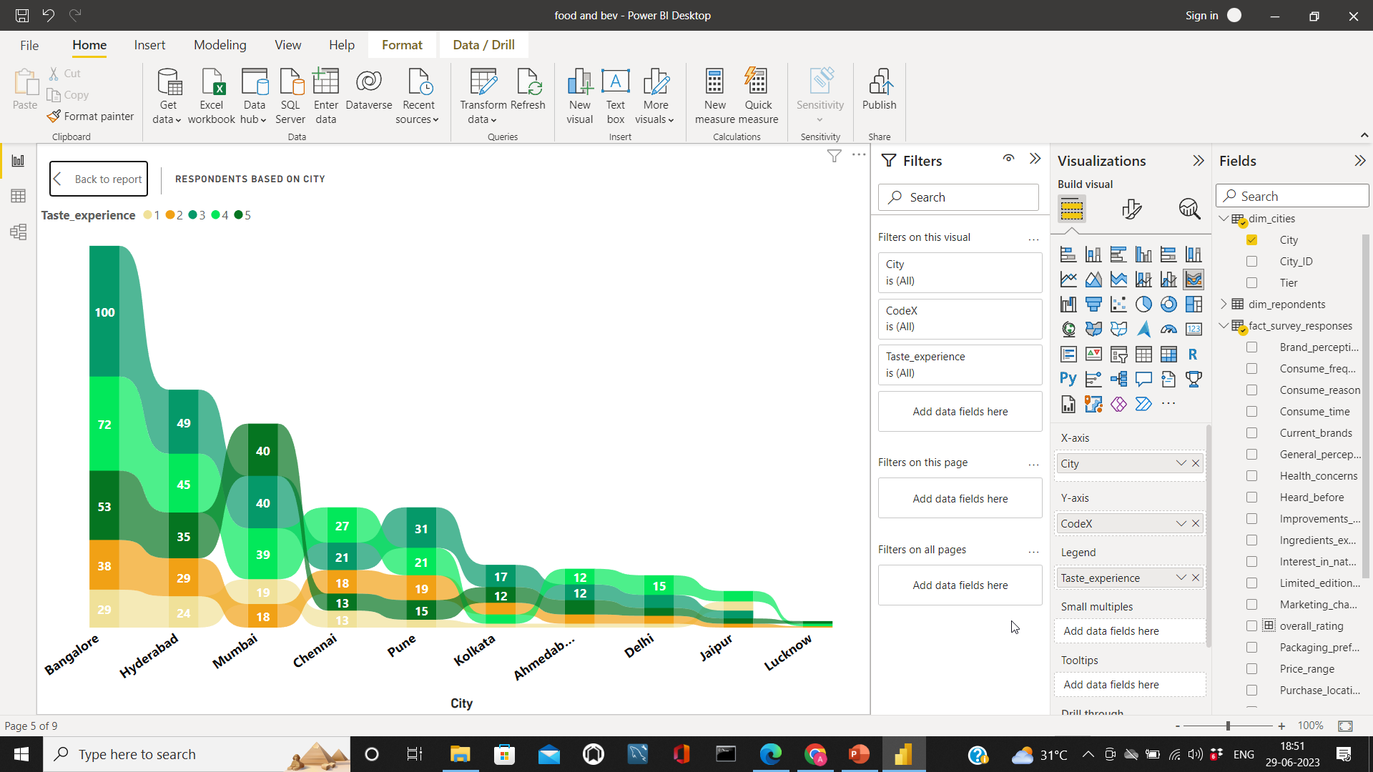
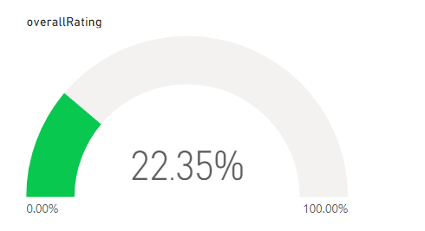
5. Brand perception
5.1 Rating of codex based on the positive response
Our positive rating is not that good.
Positively the neutral count is higher we should work on improving our perception on the product by people

Slide 16
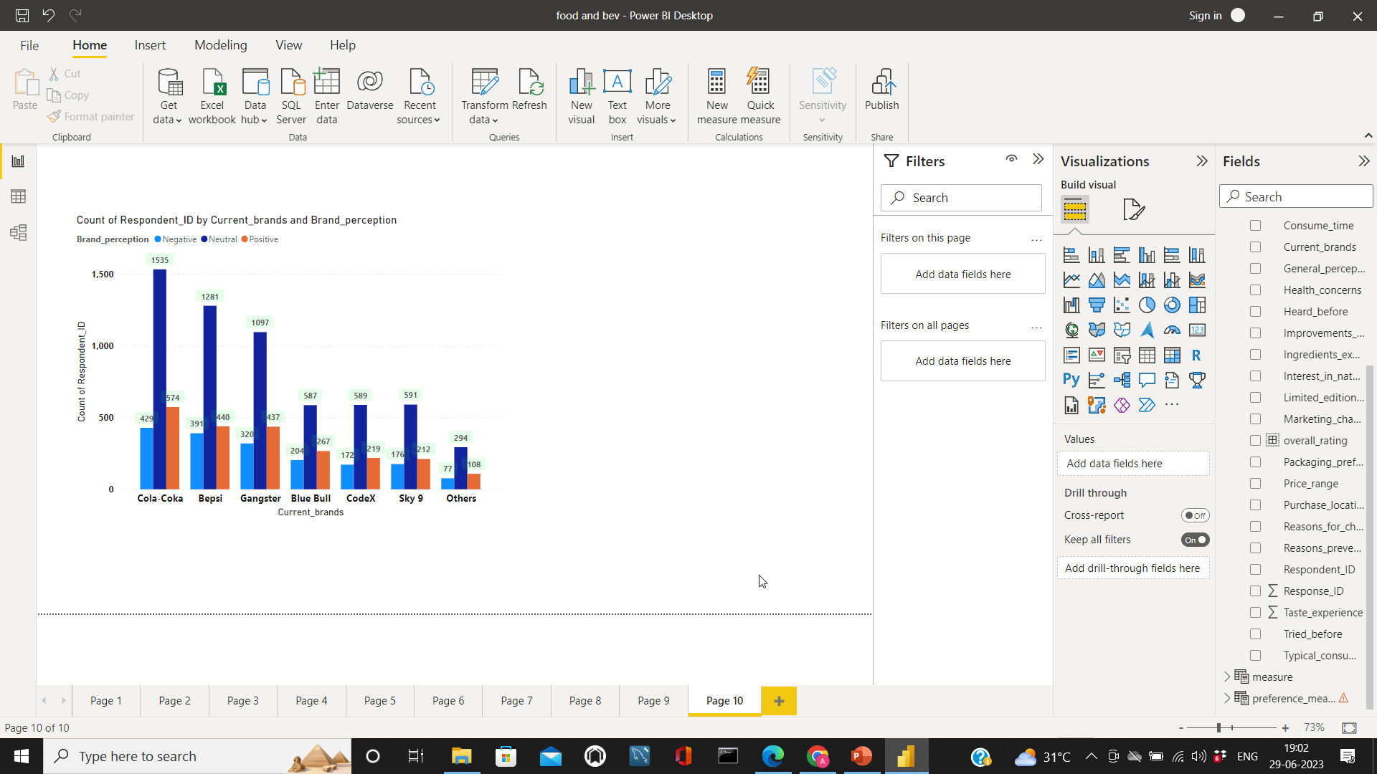
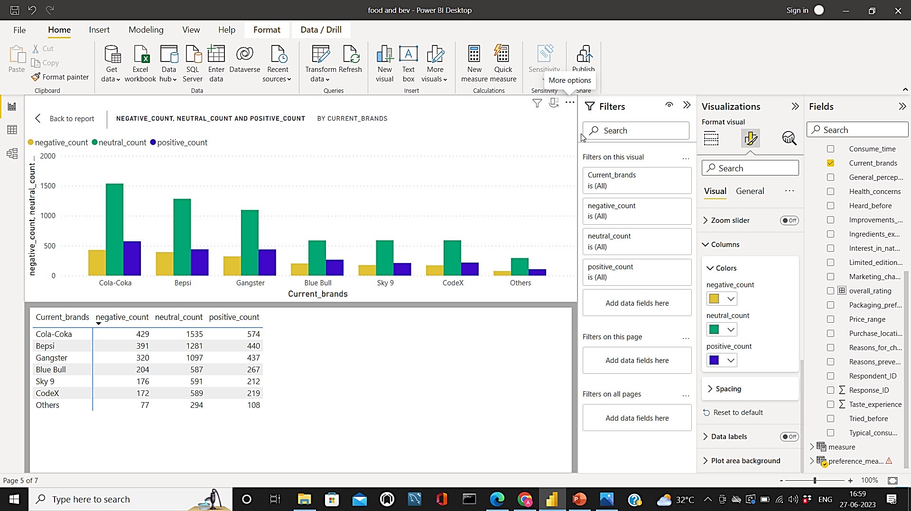
5.2 Perception with other brands
It is clearly seen that no energy drink brand has established a positive reputation.
Thus promoting our brands as healthy drink will have a great impact on sales.

Slide 17
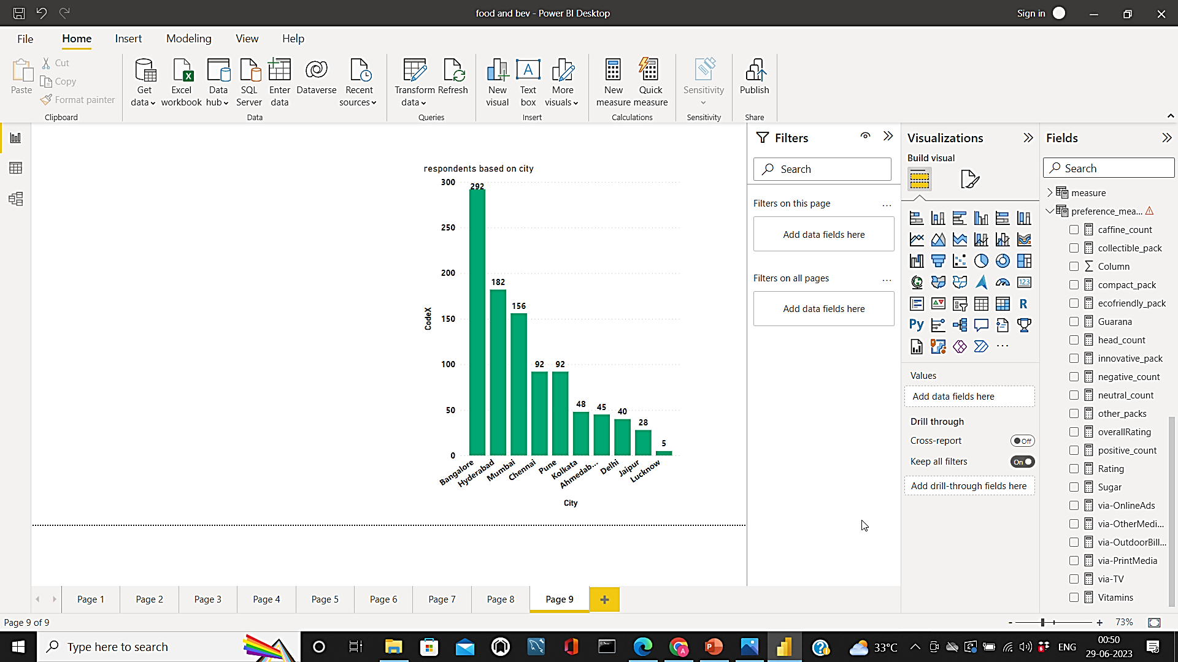
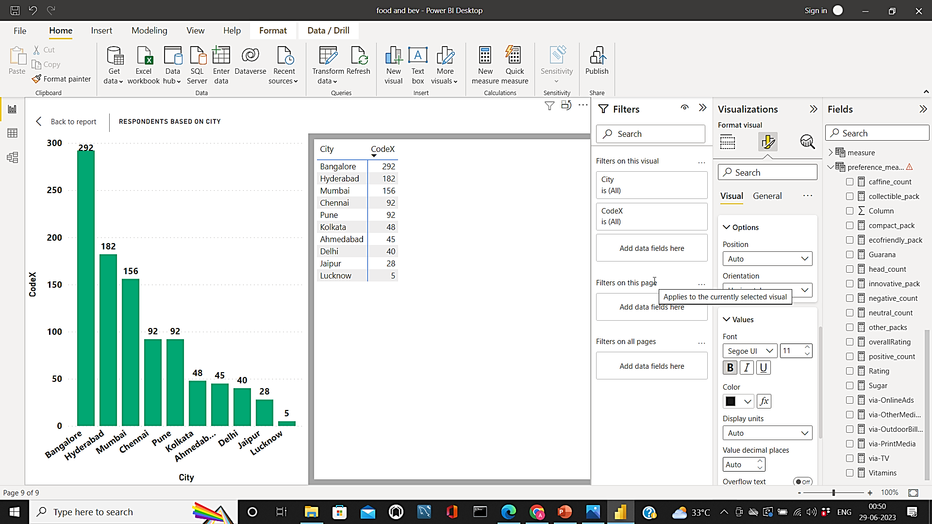
5.3 city to focus
CodeX has less than 50 consumers from Ahmedabad, Delhi, Jaipur, and Lucknow.
So we need more focus there.
Even in other cities, we don’t have very good numbers marketing needs improvement.

Slide 18
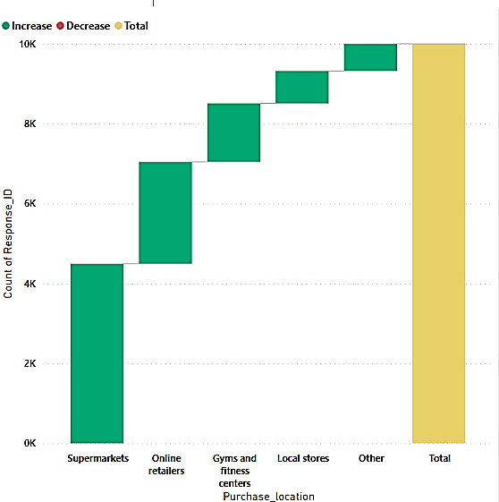
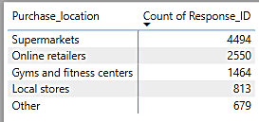
6. Purchase behavior
6.1 Purchase location preference
Most people prefer buying energy drinks in supermarkets so obtaining proper positioning is important.
Providing better offers for bulk orders via online will tend people to prefer online we can reduce middlemen.

Slide 19
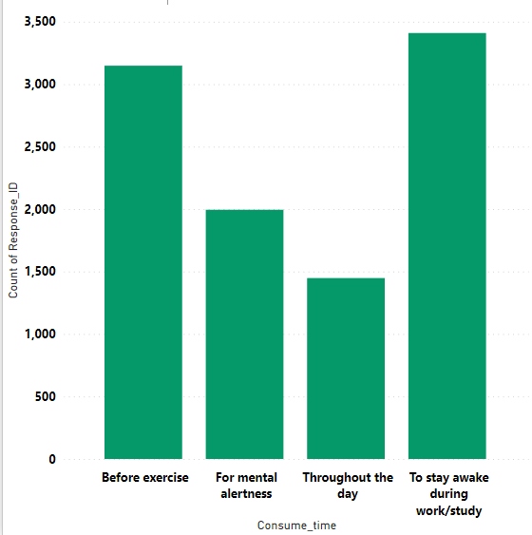
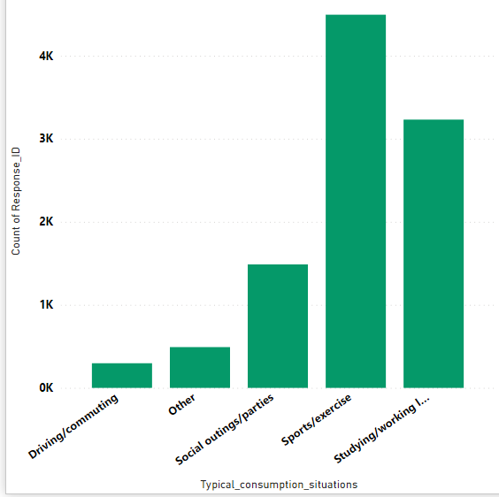
6.2 Various consuming situations
Energy drinks are primarily preferred for keeping our brain and body active.
Most people prefer energy drinks before doing exercise and before sports activities.
It is also preferred while studying to stay awake.

Slide 20
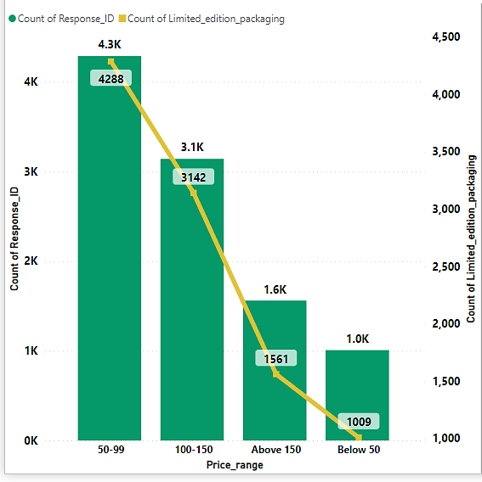
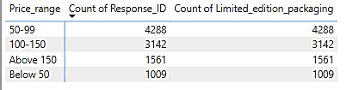
6.3 Price range and limited edition report
It is clear that if the price is less than Rs.150 people prefer limited edition packaging.
Limited edition packages should be collectible and should be based on current trends.

Slide 21
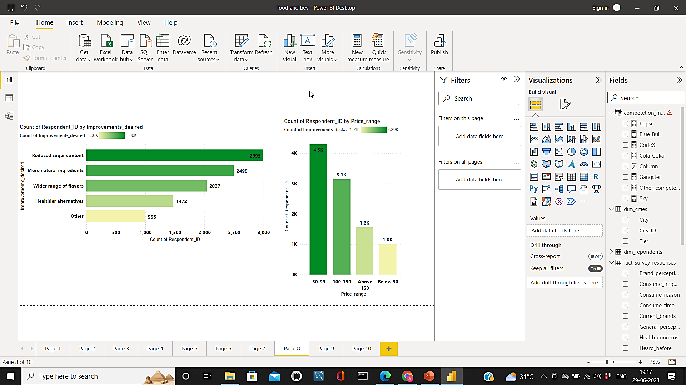
7.1 product development – focus areas:
Based on various insights derived from the data it is identified that people prefer healthy, natural, and tasty drinks to stay active.
Since it is used by sports persons the drink should have less sugar content and more caffeine.

Slide 22
Secondary insights
04

Slide 23
1. Immediate changes on the product:
Our drink is preferred by people to stay active and healthy so we should do r&d to improve the quantity of caffeine and vitamins.
The taste experience of our brand has an average as 3 so improving taste is important.
Making sure the availability of the product to the consumers.
Improving the positive perception of our brand among consumers.
In conclusion, people are expecting energy drinks that are tasty and healthy as well.

Slide 24
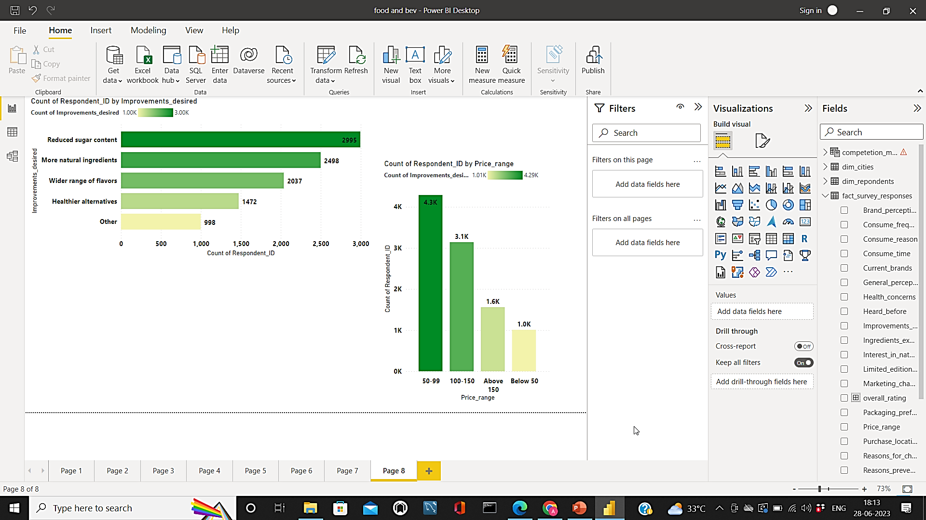
2. Optimal price for the drink
Over 10,000 respondents 7,400 respondents prefer prices between 50 and 150.
So we can have various products under Rs.150 segregated based on the quantity.
We can also provide various flavors for various prices based on the demand in the market.

Slide 25
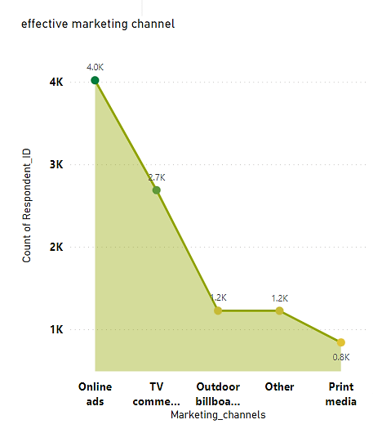
3. Marketing campaigns & offers
The offers should be coated thus the maximum price not exceeding Rs.150.
Limited edition packages should be marketed based on the trends.
Adding certain collectibles might improve the purchasing frequency.
Based on the data print media is not effective as others so the amount spent on that shall be redirected to rewards.
We should provoke the consumers to showcase their collectibles on social media this will improve the brand’s reputation as well.

Slide 26
4. Brand ambassador
Our target audiences are young sportspersons such as athletes, and cricketers with age between 15 and 30.
So our brand ambassador should be an Enthusiastic sportsperson.
In India, Cricket is one of the major sports that reach a huge audience so cricketers Should be taken into consideration.
The most effective way to attract our audience is via social media so a sportsperson preferably a cricketer with good social media influence should be selected.

Slide 27
5. Market enlargement:
Our products have reached consumers of age 19-45 but we still lag at reaching consumers under age 19.
So our marketing strategy, product, and price should be in the way to reach this age group.
This will help us in enlarging our market.

Slide 28
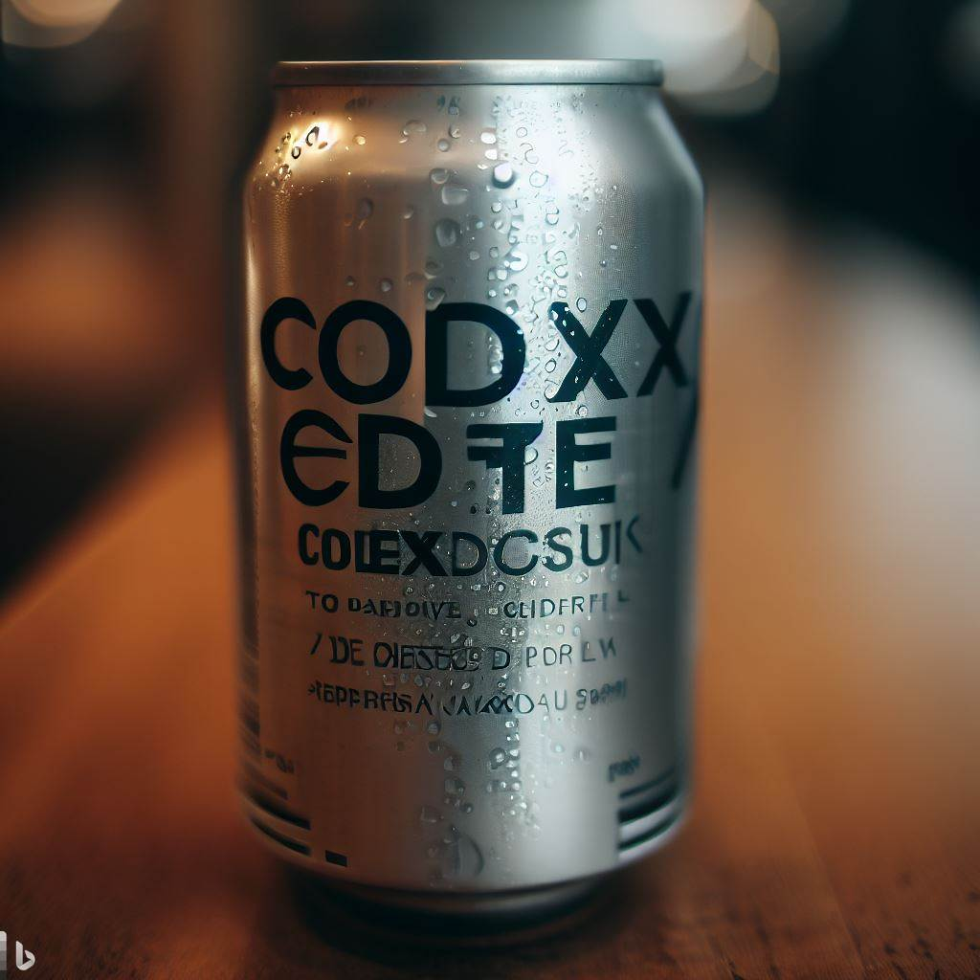
Suggestions
05
Targeted age group: 15-45
Major consumers: sports and fitness activists.
Preferred ingredients: Caffeine
Packaging: compact and innovative cans.
Marketing channel: Online ads and Tv commercials.
Brand ambassador: sports person with good social media influence.
Our product should have more flavors and should have healthy ingredients.

Slide 29
Limitations of dataset
The number of respondents we have enquired is far less than the total population of India.
The population of Delhi alone counts to 32,941,000.
This small sample size might become a cause for major deviation from the expected result.

Slide 30
Closing
06
Thank you for providing me the opportunity to showcase my skill and thanks for listening to the presentation till the end.
AKASH PRANAO.D.K
linkedin.com/in/akash-pranao

